Slide 1

Motion Control：Lecture 5.2
Interpolation of the continuous path( Line and arc)
Jiangang Li
14 Nov 2016

Slide 2


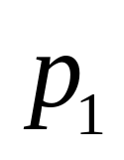
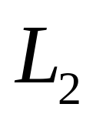
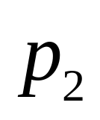
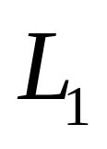
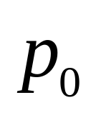
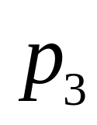
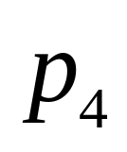
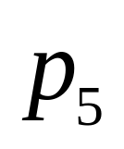
3D forms are often described by a progression of very short multi-section.
Fig 1 Continuous line segments

Slide 3
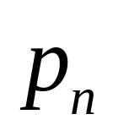
3D forms are often described by a progression of very short multi-section. The control reduces the feedrate at the discontinuous transitions in order to keep the tool exactly on path. This type motion will cause machine tool oscillations, when working in acceleration or deceleration modes.
(a) Multi-section
V
t
(b) Velocity plan
Fig 2 Multi-section trapezoidal profile velocity plan without blending

Slide 4
The feedrate variation of block A and block B is continuous. The block A does not decelerate to zero and this is called blended feedrate planning.
Block B
Blended feedrate path
Without blended feedrate path
Block A
Fig 3 Two section tool path
V
V
Blended feedrate
t
t
(a) Without blended
(b) With blended
Fig 4 Velocity plan

Slide 5





C
θ
A
B
Accurate corner error
C
θ
A
B
Approximate corner error
Fig 5 Definition of corner error

Slide 6
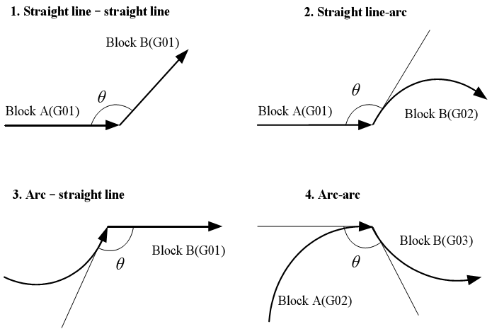
Fig 6 Type of two sections

Slide 7

There are three types of two sections velocity planning according to length of blocks. The V₁ and T_{a} defined according to Fig3.6.
V
V
V1
V1
t
t
(a) Two trapezoids
(b) one trapezoid, one triangle
V
V1
t
(c) Two triangles
Fig 7 Three type of velocity plan

Slide 8

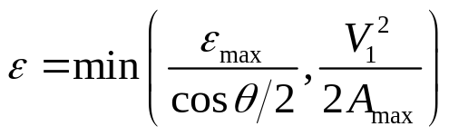





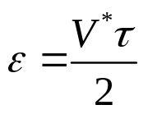


From Fig3.6(a), :
C
θ
(3-1)
A
B
(a) Tool path
Where, is given.
Block A
Block B
From Fig3.6(c):
t
(3-2)
(b) Velocity plan
(3-3)
(c) Blended area
Fig 8 Velocity and corner error

Slide 9



From Eq3.2 and Eq3.3, it can be gotten:
(3-4)
Users only set parameters of maximum corner error ( ), acceleration ( ). The blended feedrate planning can be gotten.

Slide 10
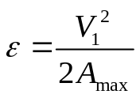



For the case,
There is constant velocity in corner.
(a)
Feedrate Planning
(b)
t
(c)
Fig 9 Constant velocity in corners

Slide 11


Some example:
Table 3.1Experiment parameters
Maximal feedrate ( ) | 50
Maximal acceleration ( ) | 200
Allowable error ( ) | 0.01
Interpolation cycle ( s ) | 0.002

Slide 12
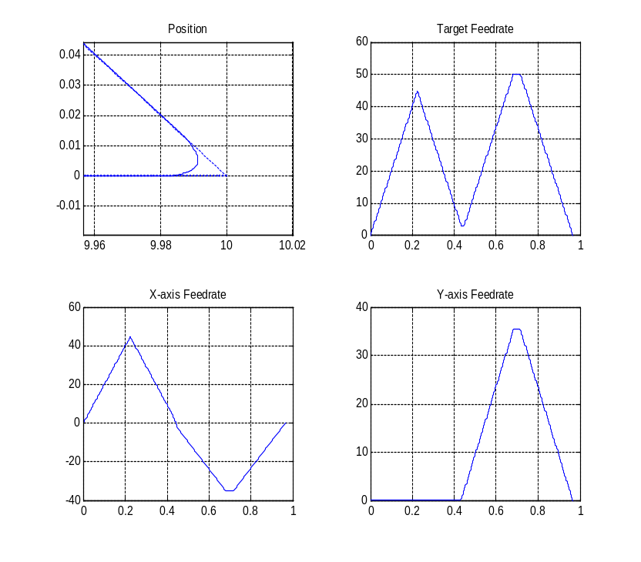
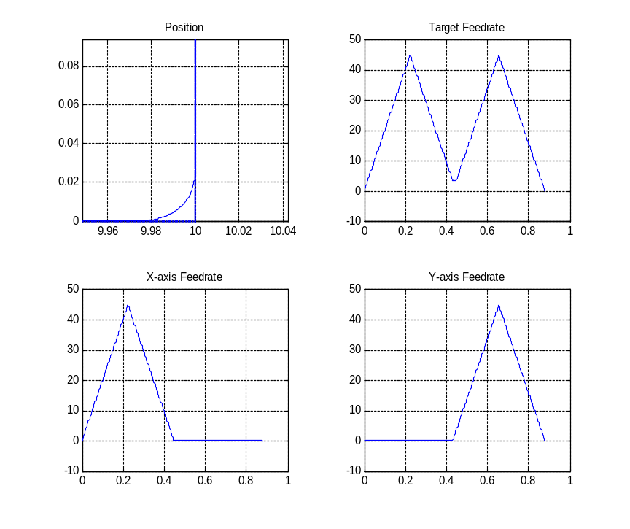
Block1 G01(mm) | X10 Y0
Block2 G01(mm) | X0 Y10
Block1 G01(mm) | X10 Y0
Block2 G01(mm) | X10 Y10
Fig 10 Connect line and line with 45-degree corner angle
Fig 11Connect line and line with 90-degree corner angle

Slide 13
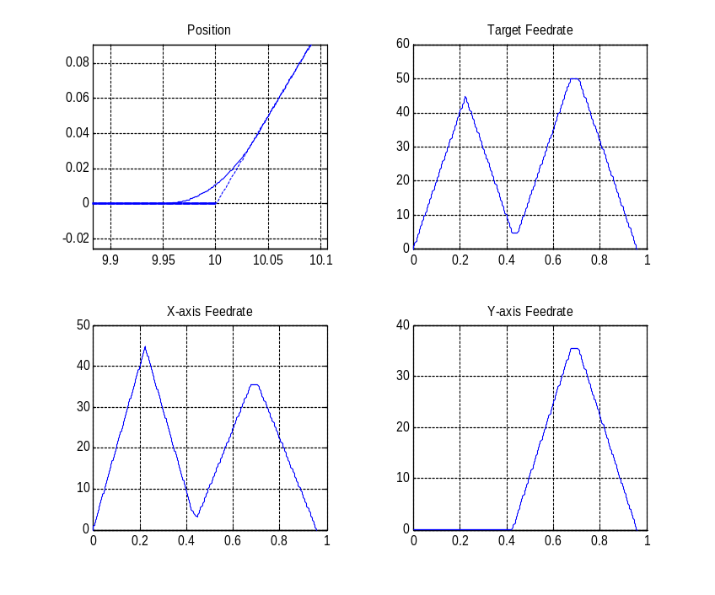
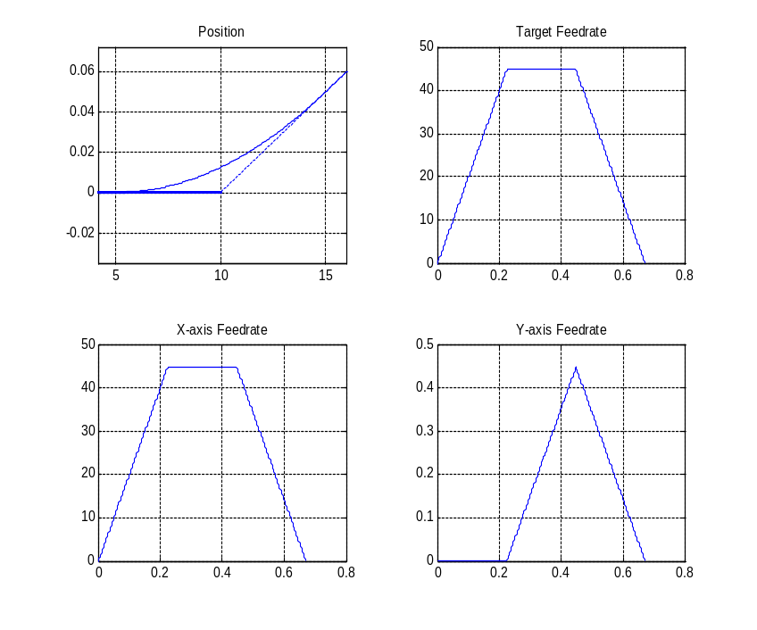
Block1 G01(mm) | X10 Y0
Block2 G01(mm) | X15 Y10
Block1 G01(mm) | X10 Y0
Block2 G01(mm) | X20 Y1
Fig12 Connect line and line with 135-degree corner angle
Fig 13 Connect line and line with big corner angle

Slide 14
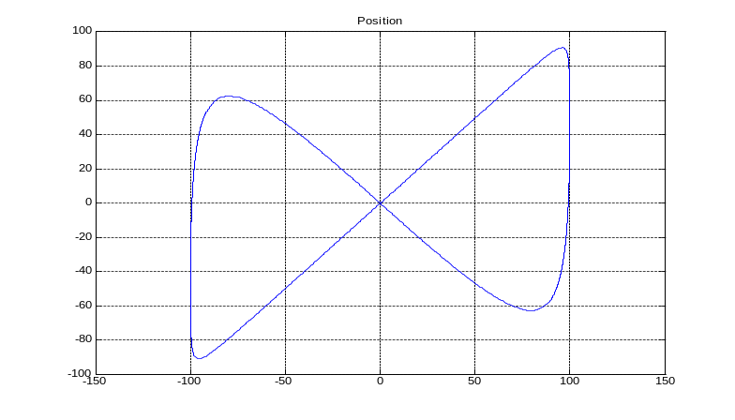
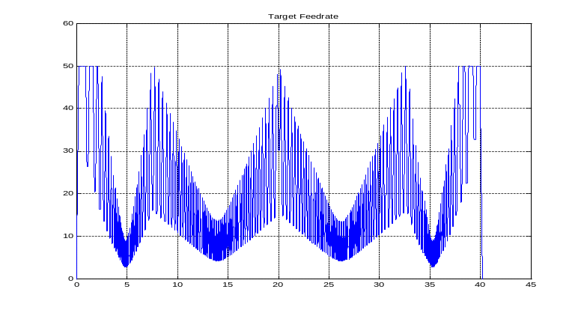
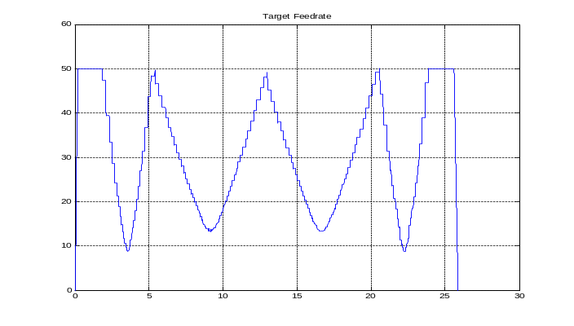


Fig 14 Continuous tool path for simulation
Fig 15 Velocity plan with
machining time is about 40s
Fig 16 Velocity plan with
machining time is about 25s

